Slide 1
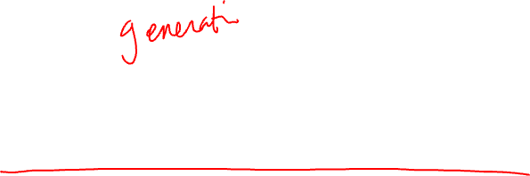
Inference and Neural Dialogue Modeling
Instructor: Kyunghyun Cho (NYU, Facebook)

Slide 2

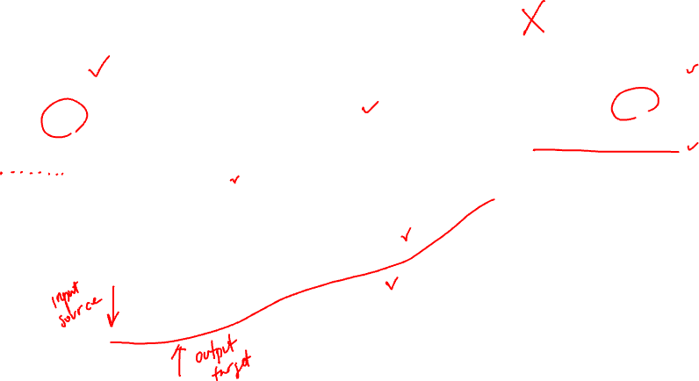
Building a simple neural conversational model
“Partner” profile
Unknown
“My” profile
I’m now looking for a new job .
my favorite movie is friday.
i am a doctor.
my daughter is a child prodigy.
hello , i ' m sitting here with my dog . how are you ?
i ' m well friend . looking for new employment at the moment .
what would be your dream job ?
?

Slide 3
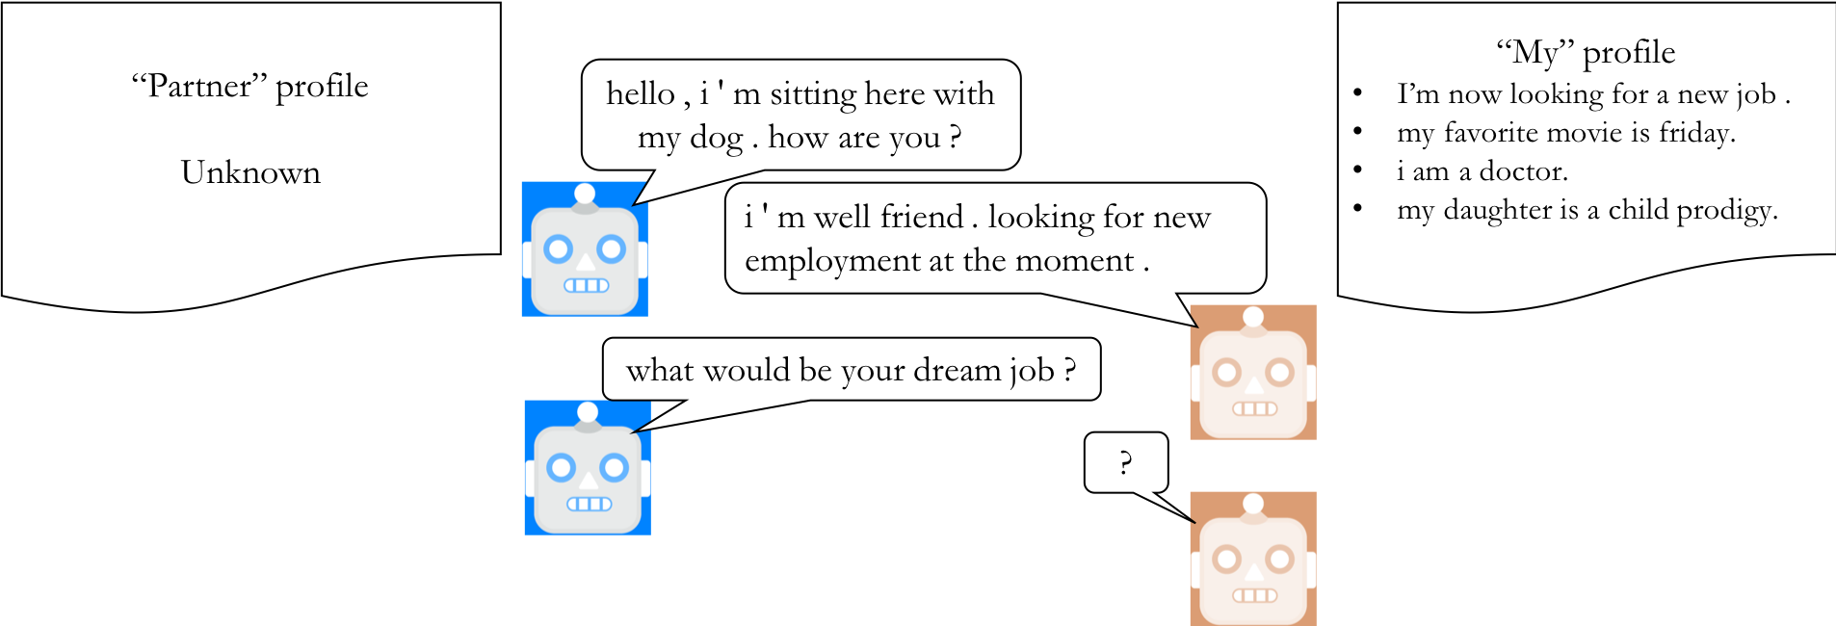
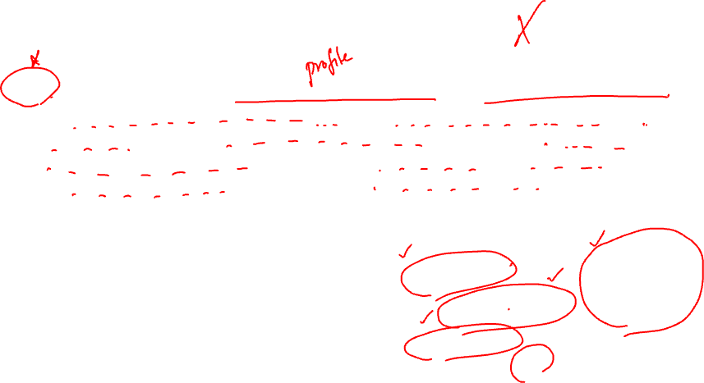
Building a simple neural conversational model
Input: a flat sequence of personality descriptions and previous utterances
<p>I’m now looking for a new job.<\n><p>my favourite movie is friday.<p>I am a doctor<\n><p>my daughter is a child prodigy<\n><u1>hello, I’m sitting here with my dog. How are you?<\n><u2>I’m well friend. Looking for new employment at the moment.<\n><u1>what would be your dream job?<\n>

Slide 4
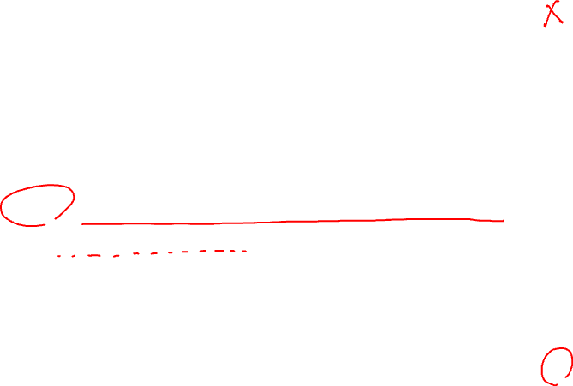
Building a simple neural conversational model
Input: a flat sequence of personality descriptions and previous utterances
<p>I’m now looking for a new job.<\n><p>my favourite movie is friday.<p>I am a doctor<\n><p>my daughter is a child prodigy<\n><u1>hello, I’m sitting here with my dog. How are you?<\n><u2>I’m well friend. Looking for new employment at the moment.<\n><u1>what would be your dream job?<\n>
Target: a flat sequence of human/annotator’s reponse
My dream job is to teach at a medical school.<\n>*
* I just made this up…

Slide 5
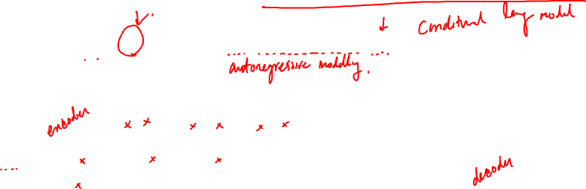
Neural conversation as neural machine translation
Input : personality descriptions + pervious utterances
Encoder maps the input to a set of vectors
Decoder predicts the next symbol
A discrete sequence output

Slide 6
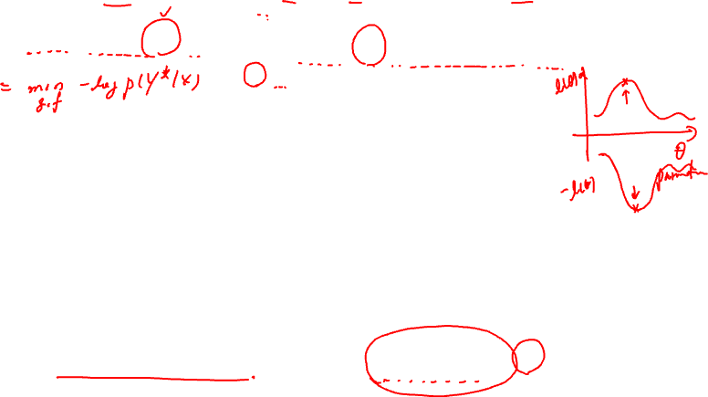
Learning – Maximum Log-Likelihood Learning
Maximizes the log-probability of a correct next utterance
Learns to predict the next token:

Slide 7

Learning – Maximum Log-Likelihood Learning
We know how to train this pretty well (now)
Long short-term memory (LSTM, Hochreiter&Schmidhuber, 1999)
Gated recurrent units (GRU, Cho et al., 2014)
Convolutional networks (Dauphin et al., 2017), Time delay networks (Waibel et al., 1989)
Memory networks (Sukhbataar et al., 2016), Self-Attention (Vaswani et al., 2017)

Slide 8
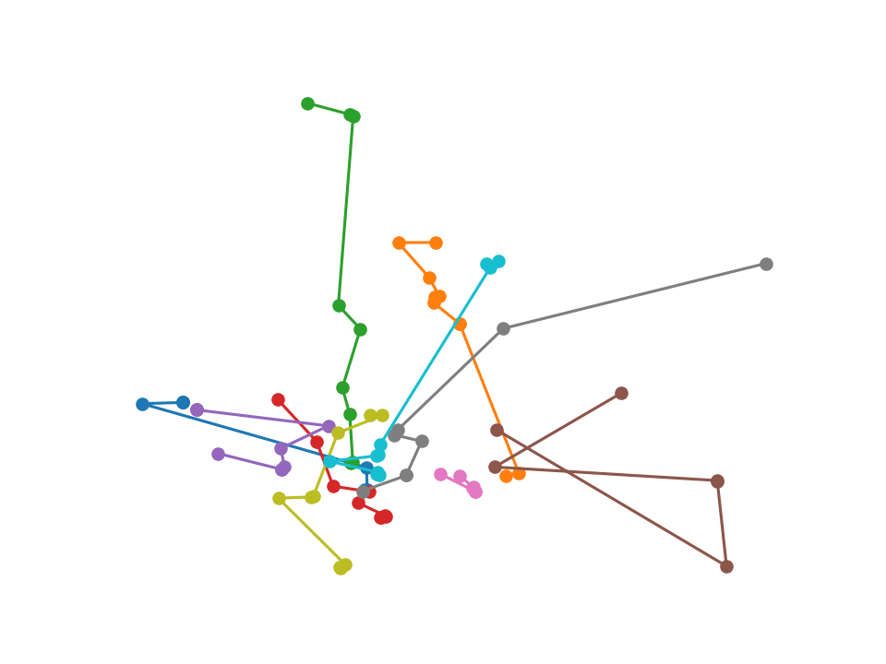
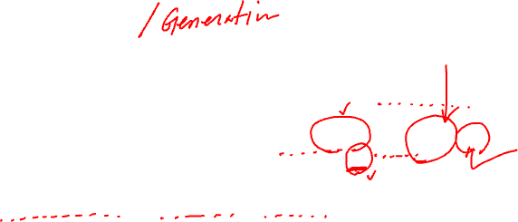
Inference
Finding a relatively-heavy needle in a exponentially-large haystack
Approximate, sequential local search
Greedy search
Beam search
And more…

Slide 9
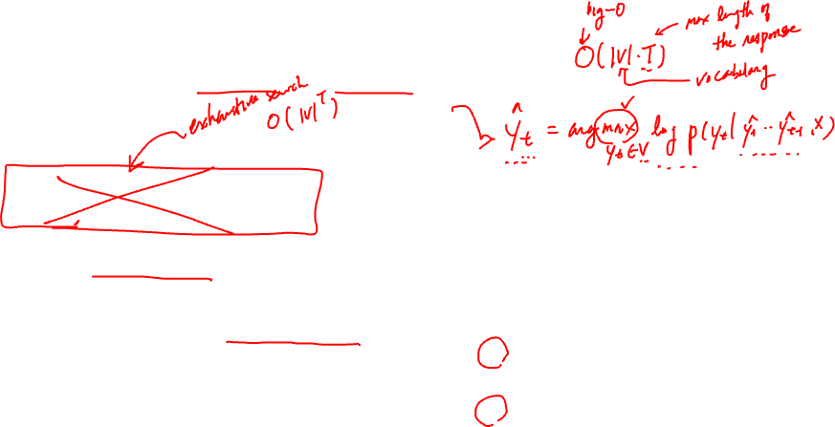
Inference – Greedy search
Choose the best symbol each time step
Heavily sub-optimal
No future consequence considered
Early commitment cannot be reverted
Somehow, most widely used in neural dialogue generation…

Slide 10
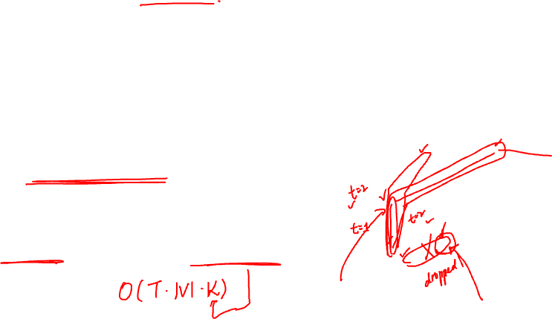
Inference – Beam search
de facto standard in neural language generation
Machine translation
Better than greedy search, because no early commitment to any token
Future consequences are taken into account up to a certain level
Controlled complexity: beam width

Slide 11
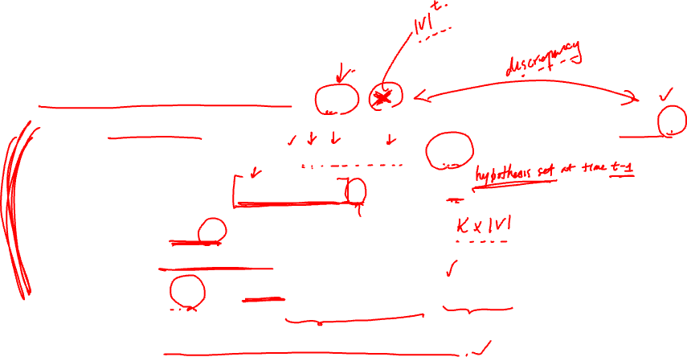
Beam search in detail
Exact search is intractable because
Instead, beam search limits the size of hypothesis set at each time step:
By expanding each hypothesis with all possible unique words
We end up with candidate hypotheses
Construct the next hypothesis set by
Continue until all the hypotheses terminate (<eos>)

Slide 12
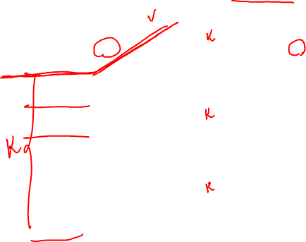
Beam search in autoregressive models
Expansion
top-K selection

Slide 13
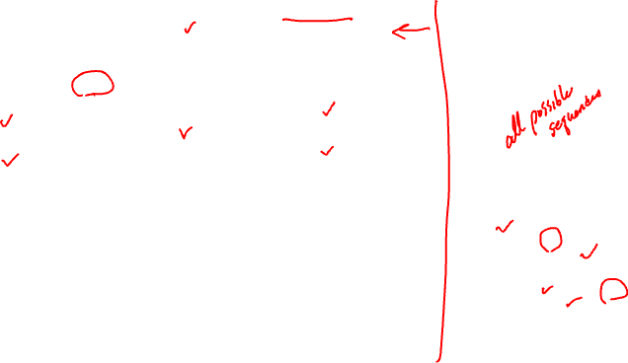
Beam search in autoregressive models
Expansion
top-K selection
Global View

Slide 14

Inference – Iterative Beam search
Inspired by Batra et al. [2012] and Li&Jurafsky [2016]
Covers a larger search space than beam search by avoiding any search subspace explored by earlier iterations of beam search
More effective than simply increasing the beam width: higher diversity
No additional hyperparameter
# of iterations: computational budget
* Efficient semi-parallel implementation is possible and available.

Slide 15
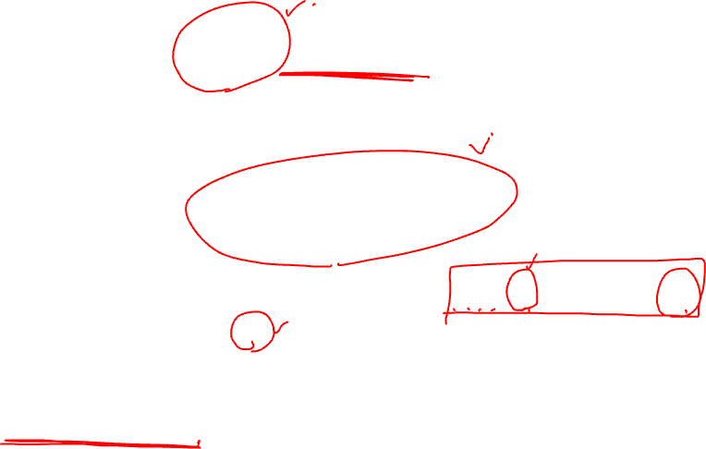
Inference – top-K sampling
Introduced in, e.g., [Fan et al., 2018]
Ancestral sampling from where
I have absolutely no idea what this distribution actually looks like
Stochastic behavior → problematic for evaluation and debugging

Slide 16
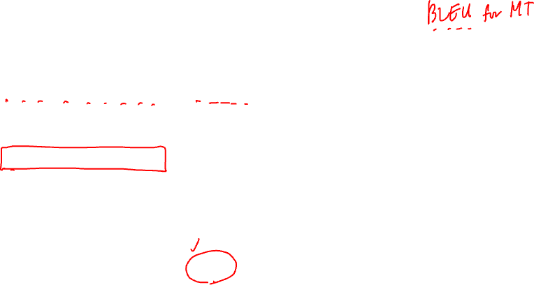
Human evaluation
Single-turn evaluation is not enough
Exposure bias
Self-consistency
Multi-turn evaluation is necessary
Multi-turn human-bot conversation
Absolute scoring
hello , i ' m sitting here with my dog . how are you ?
“Bot” profile
I’m now looking for a new job .
my favorite movie is friday.
i am a doctor.
my daughter is a child prodigy.
?
?
?
“Human” profile
Unknown to the “bot”

Slide 17
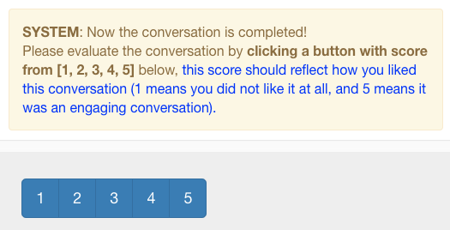

Multi-turn evaluation and absolute scoring
A human evaluator makes a conversation of at least 5-6 turns with a bot.
Each conversation is scored from {1, 2, 3, 4}

Slide 18
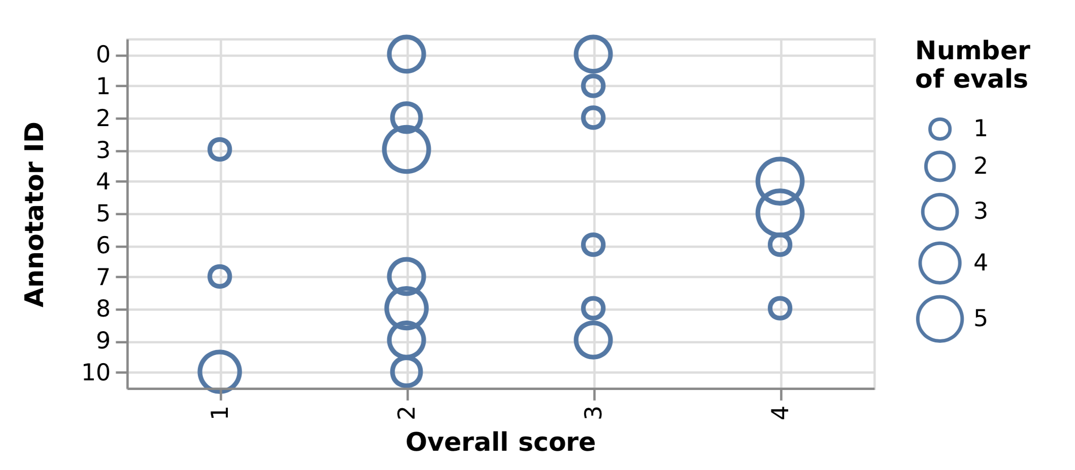
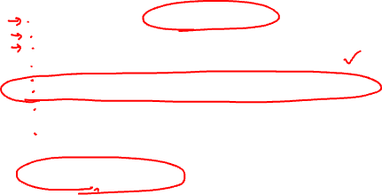
Multi-turn evaluation and absolute scoring
Each conversation is scored from {1, 2, 3, 4, 5}
The evaluator is also asked to mark each bot utterance as “good” or “bad”.
Unfortunately, human evaluators are not well-calibrated
Some are too generous, while others are too harsh, and some are just random…

Slide 19
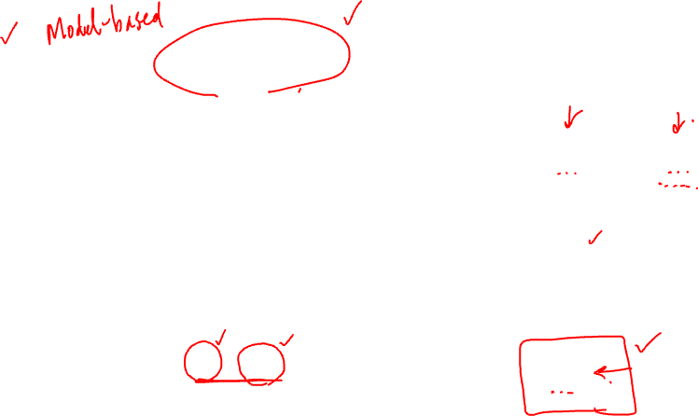
Bayesian calibration of evaluation scores
Model score (unobserved)
Evaluator bias (unobserved)
Collected scores (partially observed)
Inference: NUTS [Hoffman&Gelman, 2011]
Used Pyro* for inference and generality
* https://eng.uber.com/pyro/

Slide 20
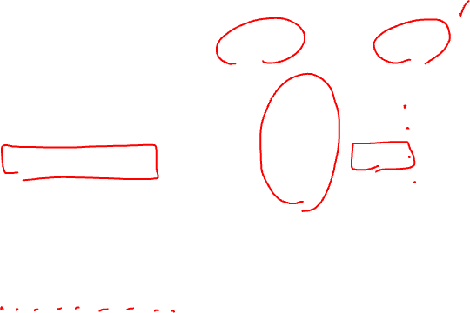
Human evaluation [Kulikov et al., arXiv 2018]
Search Algorithm | Raw scores |  | Calibrated scores
 | Average | Std. Dev. | Average | Std. Dev.
Greedy | 2.56 | 0.98 | 2.40 | 0.25
Beam(10) | 2.67 | 0.86 | 2.66 | 0.25
Iterative Beam(5,15) | 2.80 | 0.90 | 2.75 | 0.26
Human | 3.62 | 0.71 | 3.46 | 0.26
Up to 0.35/4.0 improvement with a better search algorithm
Without Bayesian calibration, too large a std. dev. due to the evaluator bias
Search/inference matters.

